Slide 1
RCIA RITE OF CHRISTIAN INITIATION

Slide 2
OUR FATHER
Our Father, who art in heaven, hallowed be thy name; thy kingdom come, thy will be done on earth as it is in heaven. Give us this day our daily bread, and forgive us our trespasses, as we forgive those who trespass against us; and lead us not into temptation, but deliver us from evil.
Amen.

Slide 3
GETTING TO KNOW YOU!
What is your name?
Have you attended Mass at St. Pius X for long, and how would you describe it as a parish? If not, what are you most looking forward to learning about the parish?
What brought you to this class or called you to inquire about the Catholic Faith?

Slide 4
AGENDA
Inquiry
So, you want to become Catholic. Now what?
Catechumenate
Period of Catechesis (Religious Instruction)
Literally means, “to echo”
Purification & Enlightenment
Period of Prayer and Discernment
Holy Week
Easter Vigil
Mystagogy
Continued catechesis and welcoming into the family of faith.
RCIA Process
Mass Attendance
Calendar/Topics
Candidates vs. Catechumens
Baptismal Certificates
Godparents/Sponsors
Weekly Procedures – Gospel (Liturgical Year), Lesson, Discussion, Prayer
Homework – Video, Workbook
Formed.org & other resources

Slide 5
AGENDA
“Catholics go to Mass.”
Weekend Masses
Saturday Vigil - 5:00 PM
Sundays - 7:30 AM, 9:00 AM, 11:30 AM
Daily Masses
Mon, Thurs, Fri - 5:15 PM
Tues - 8:30 AM
Cross your arms for a blessing!
RCIA Process
Mass Attendance
Calendar/Topics
Candidates vs. Catechumens
Baptismal Certificates
Godparents/Sponsors
Weekly Procedures – Gospel (Liturgical Year), Lesson, Discussion, Prayer
Homework – Video, Workbook
Formed.org & other resources

Slide 6
AGENDA
Liturgical Calendar
Ordinary Time - Green
Advent - Purple
Christmas - White
Ordinary Time - Green
Lent - Purple
Triduum - Red
Easter - White
Feast Days – Red or White
Course Calendar
Weekly Topics Covered
Important Dates
RCIA Process
Mass Attendance
Calendar/Topics
Candidates vs. Catechumens
Baptismal Certificates
Godparents/Sponsors
Weekly Procedures – Gospel (Liturgical Year), Lesson, Discussion, Prayer
Homework – Video, Workbook
Formed.org & other resources

Slide 7
AGENDA
Catechumen
Unbaptized
Need Godparent/Sponsor Eligibility Form
Candidate
Already baptized
Need verification of your baptism in any Christian denomination.
Need Godparent/Sponsor Eligibility Form
Godparent/Sponsor
Practicing Catholic “in good standing” with the Catholic Church
What does this mean?
Only need one!
RCIA Process
Mass Attendance
Calendar/Topics
Candidates vs. Catechumens
Baptismal Certificates
Godparents/Sponsors
Weekly Procedures – Gospel (Liturgical Year), Lesson, Discussion, Prayer
Homework – Video, Workbook
Formed.org & other resources

Slide 8
AGENDA
What will classes look like?
Prayer
Questions from previous week
Lesson & Discussion
Prayer
At Home
Resources for the next week
Bible, Catechism, Videos, etc.
www.stpiusxnc.com/rcia-2025
RCIA Process
Mass Attendance
Calendar/Topics
Candidates vs. Catechumens
Baptismal Certificates
Godparents/Sponsors
Weekly Procedures – Gospel (Liturgical Year), Lesson, Discussion, Prayer
Homework – Video, Workbook
Formed.org & other resources

Slide 9
AGENDA
Formed.org (Web & App)
“Sign Up” / “Sign Up as a Parishioner”
Enter: “St. Pius X” and select the one in Greensboro, NC
Click “Next” and enter your personal information.
Use on desktop or download the app for your device.
All Symbolon videos can be found here.
Laudate (App Store)
Realm (App Store)
USCCB (Web)
RCIA Process
Mass Attendance
Calendar/Topics
Candidates vs. Catechumens
Baptismal Certificates
Godparents/Sponsors
Weekly Procedures – Gospel (Liturgical Year), Lesson, Discussion, Prayer
Homework – Video, Workbook
Formed.org & other resources

Slide 10
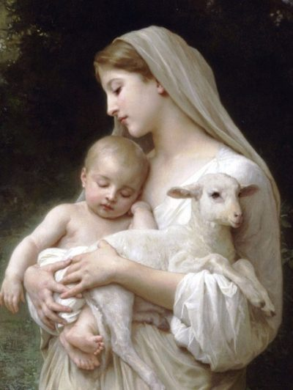
HAIL MARY
Hail, Mary, full of grace, the Lord is with thee. Blessed art thou among women and blessed is the fruit of thy womb, Jesus. Holy Mary, Mother of God, pray for us sinners, now and at the hour of our death.
Amen.

