Slide 1
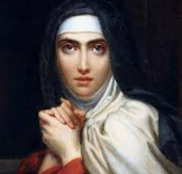
St. Theresa of Avila – Feast day Oct 15
Born 1515 in Avila, Spain
Mystic and great reformer of the Carmelite Order
With St. John of the Cross, founded the Discalced Carmelites
Wrote The Interior Castle, about the soul’s journey to God
Died 1582, canonized in 1622, declared Doctor of the Church, 1970
Patron Saint of headache sufferers
“For mental prayer, in my opinion, is nothing else than an intimate sharing between friends; it means taking time frequently to be alone with Him who we know loves us.”
“Let nothing disturb you, let nothing frighten you, all things are passing away: God never changes. Patience obtains all things. Whoever has God lacks nothing; God alone suffices.”
“If this is how You treat Your friends, no wonder You have so few of them!”
“From silly devotions and sour-faced saints, good Lord, deliver us!”
“God walks among the pots and pans”

Slide 2
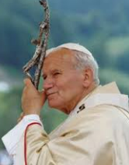
St. John Paul II – Feast day October 11
Born Karol Wojtyla 1920, Poland
Avid sportsman, poet, active in theater
Studied for priesthood clandestinely during Nazi occupation, ordained 1946
Appointed bishop 1958, and cardinal 1967
At Vatican II, significant contributor to writings
Became Pope 1978
Prolific writer including weekly series: “Theology of the Body. Visited 124 countries. Began World Youth Day
Narrowly survived assassination attempt 1981. Visited and forgave his attacker
Died 2005; Canonized 2014

Slide 3
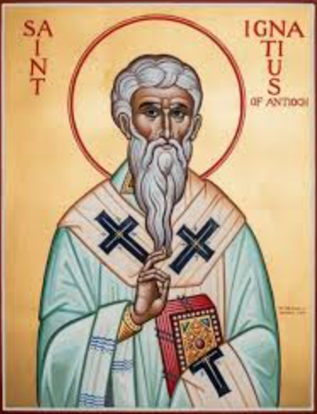
St. Ignatius of Antioch – Feast day Oct 17
Born Syria c 50 AD, died 107
Second bishop of Antioch; Disciple of St. John, Apostle
Condemned to death for his faith
On journey to his death in Rome, wrote 7 letters
  Discussed hierarchy / structure of the Church
  Teachings of the Christian faith
    e.g. Confirmed teaching of Eucharist as body and blood of Christ
    First used term "catholic“ (gr. “according to the whole”) to describe the Church.
  Letters connect us to the early Church and the unbroken, clear teaching of the Apostles which was given to them directly by Jesus Christ.
Martyred, devoured by lions in the Circus Maximus
I desire the bread of God, which is the flesh of Jesus Christ
I am God's wheat and shall be ground by their teeth so that I may become Christ's pure bread... I prefer death in Christ Jesus to power over the farthest limits of the earth.

Slide 4
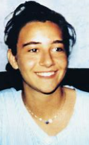
Blessed Chiara Badano – Feast day Oct 29
Born 1971 Sassello, Italy
Devout faith even as a child and often teased for her religious convictions and virtuous living
Age 16 - diagnosed with bone cancer
Refused pain medication because she didn’t want her mental faculties diminished. Chose to go for walks with another patient suffering depression than stay in bed.
Offered all of her pain and suffering to the Lord. Planned her own funeral as a wedding – she wore a white dress – her wedding dress to become the bride of Christ.
Died 1990, beatified 2010
Patroness of youth

